Slide 1
FWD Project
TOGAF 9 - Core Diagrams Product Lyfecycle Diagram Phase B – Business Architecture

Slide 2
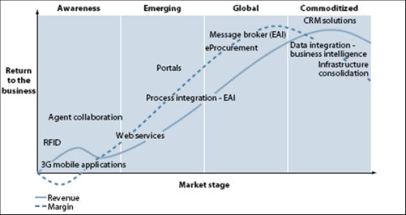
Product Lyfecycle Diagram

Slide 3
Product Lyfecycle Diagram

Slide 4
Product Lyfecycle Diagram

